Slide 1
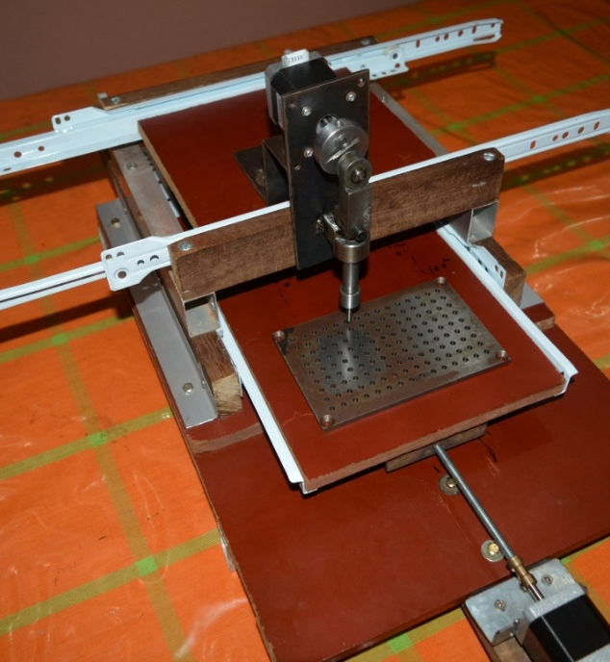
Group Number 37
Punch Card Based Prescription System

Slide 2
Aims and Objectives
Aim
Inventing a new method of prescription and developing efficient system for both pharmacies and hospitals.
Objectives
To create a CNC machine (punch card printer) to print the relevant punch card
To design the punch card
To find the suitable way to transfer data to the device from computer
To design the most suitable system to read the punch card (punch card reader)

Slide 3
Database
Interface
Punch Card
USB module
Atmega32
Microcontrollor
Going through LEDs and LDR combination
Microcontroller
Stepper motor 1
X axis
Stepper motor 2
Y axis
Display
Stepper motor 3
Puncher

Slide 4
Estimated cost and Expenditure so far
Hardware
Power supply(12V)
Atmega32 + development board 650
Stepper motors
1300*2 +800 3400
Motor driver boards (420*2) 840
Drawer railings (250*2) 500
Linear Guide 1500
Ball Screw 3200
Aluminum Box bar 400
Voltage regulators*3 + other electronics 700
Repairing cost 550
Power jack 60
Nuts and bolts 200
Guiding plates for puncher
Capacitors, Ocillators
Wood sheets
Iron plates
Display 16*4
LED, resistors(100k,10k,100)
LDR sensors
Total Rs 17300
Software
Atmel studio

Slide 5
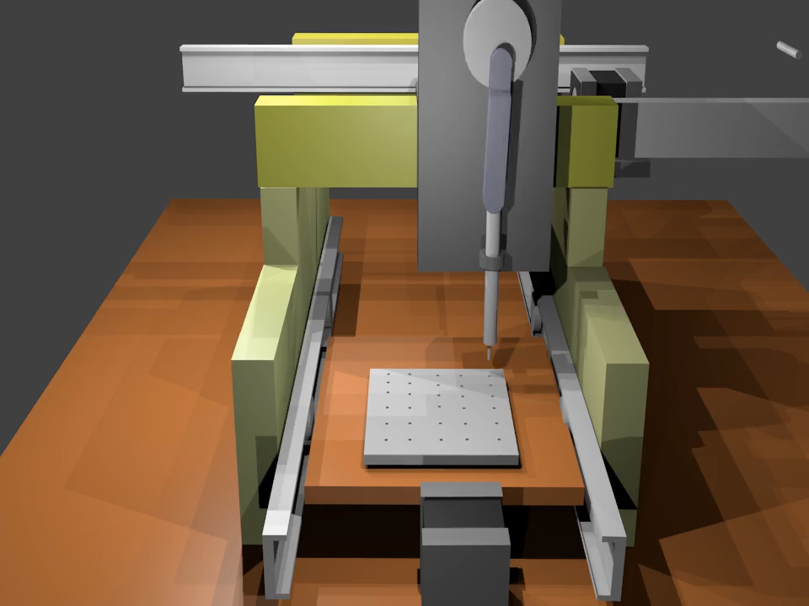
Individual Contribution

Slide 6
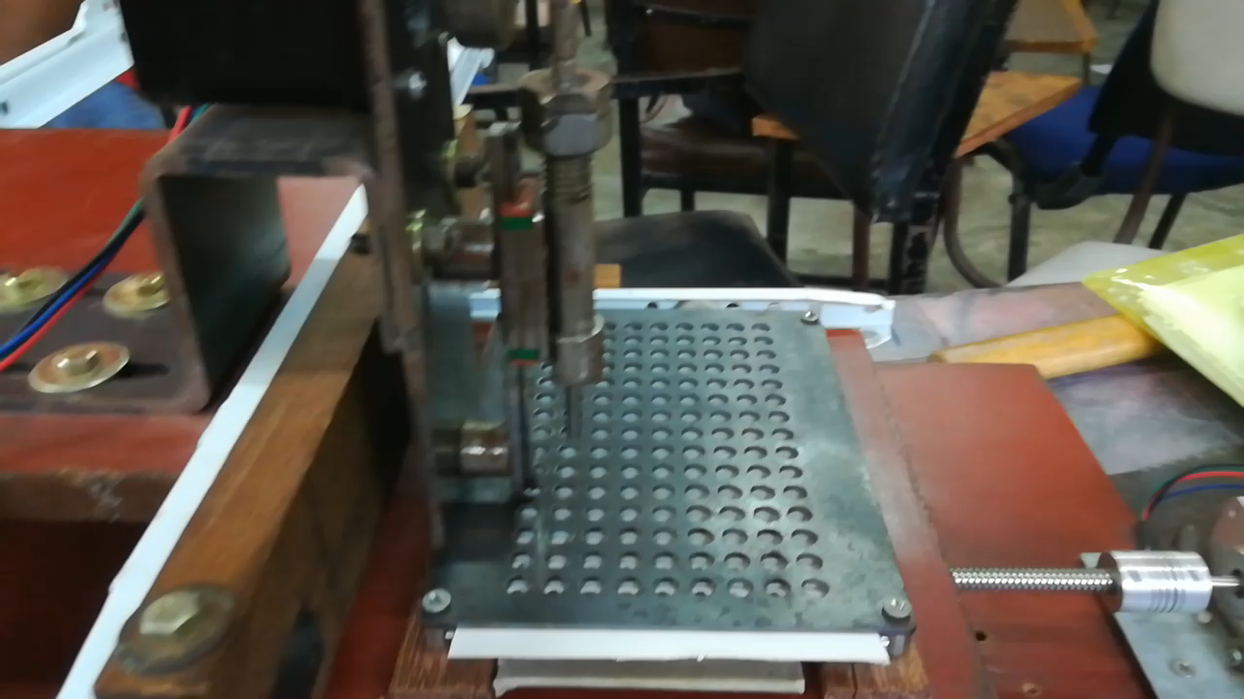
Punching Mechanism

Slide 7
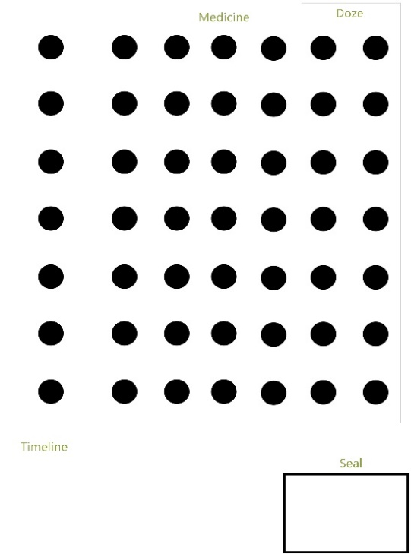
Individual Contribution
Quantity
Medicine
W.P.C.P. Pathirana(Group Leader) (184116R)
Designed the punch card reader
Structure of the punch card
16*4 LCD
LED and LDR arrays
PCB design of both printer and reader
Seal
Timeline

Slide 8
E.A.Y.R.Edirisinghe(184038E)
Designed the Interface to input the data
Studied database management and created a database to store the data (Medicine, dose)
Made 3D structure of the project
Contributed to the hardware part
Implement the connection between PC to device using UART (Serial)

Slide 9
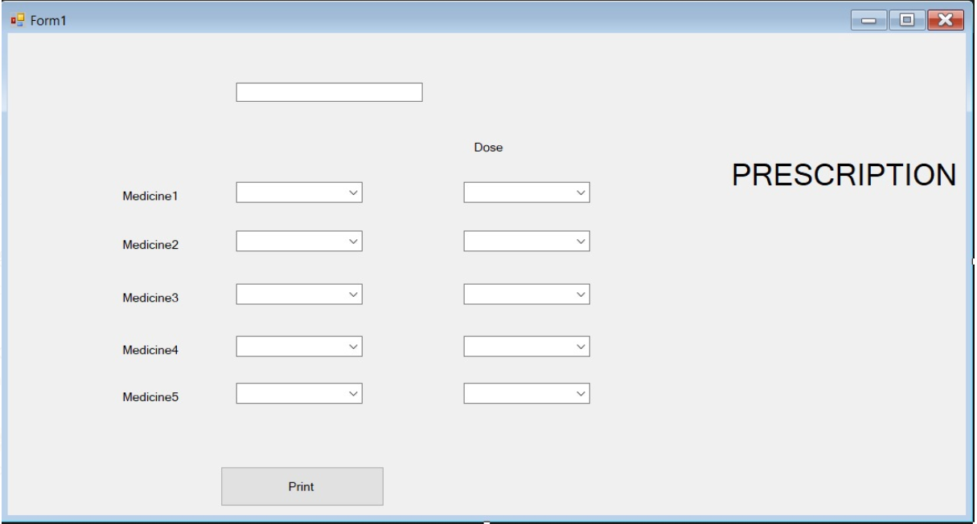

Slide 10
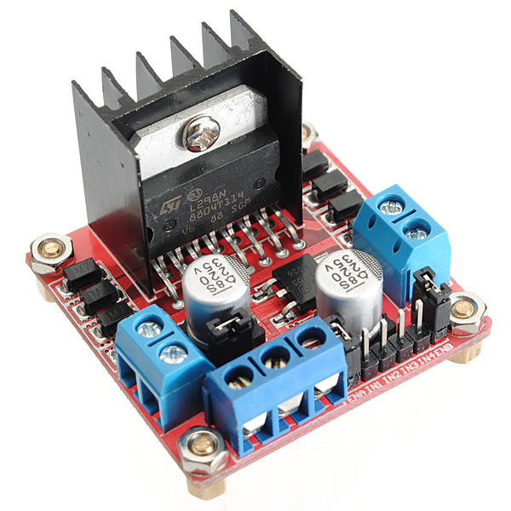
G.B.S.Jayawardena(184065H)
Contributed to the hardware part (punch card printer)
Studied stepper motor control board , voltage regulators etc.
Contributed to Program the Microcontroller and test

Slide 11
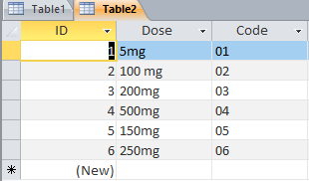
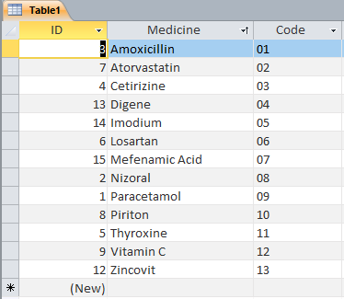
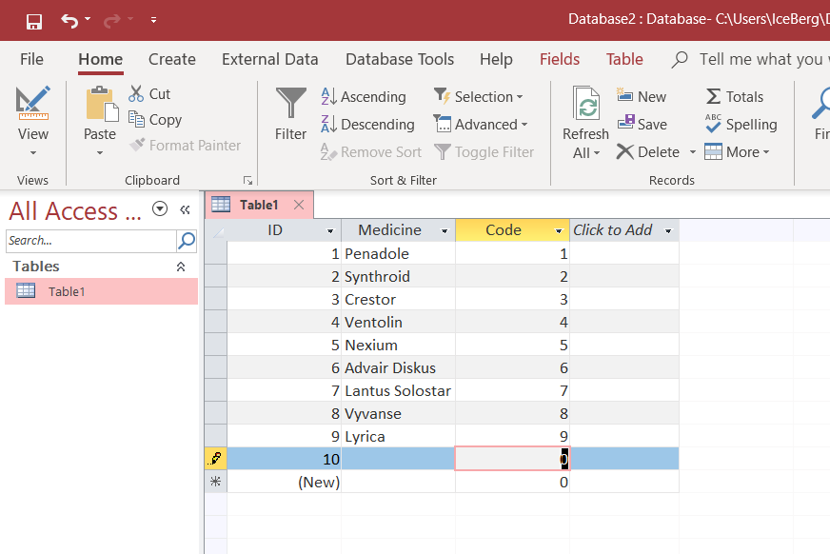
M.D.D.S.Jayanath (184059T)
Collected data for the database
Designed a structure for the punch card
Contributed to the programming and testing (punch card printer)

Slide 12
D.H.D.N.Rathnayake (184140J)
Contributed to the coding used in punch card printer
Design the punch card

Slide 13
Thank You

